Slide 1
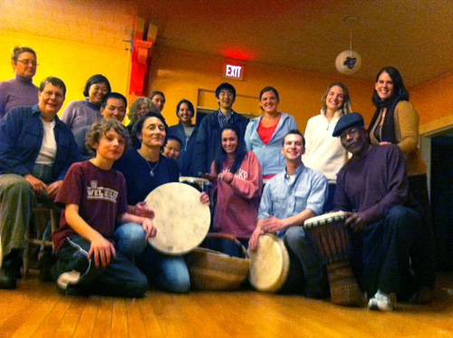

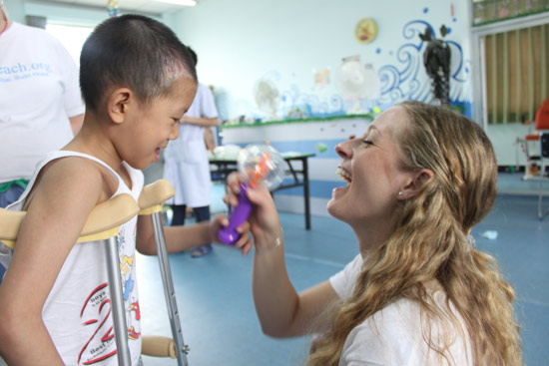
Join the HandReach BeatBrigade!
Learn to provide therapeutic drum circles for trauma survivors in Massachusetts and abroad.
Training sessions held Tuesday evenings in Boston–
a shuttle will depart from the Curry Student Center at 6:30pm and return at 9:30pm.
HandReach's mission is to make sure that best practices in pediatric burn and amputee care
and rehabilitation are available around the world,
where they are needed most.
Contact: Prof. Brecken Chinn Swartz
bchinnswartz@curry.edu
202-213-9267

